Slide 1
Introduction to Construction (VET)
Year 10

Slide 2
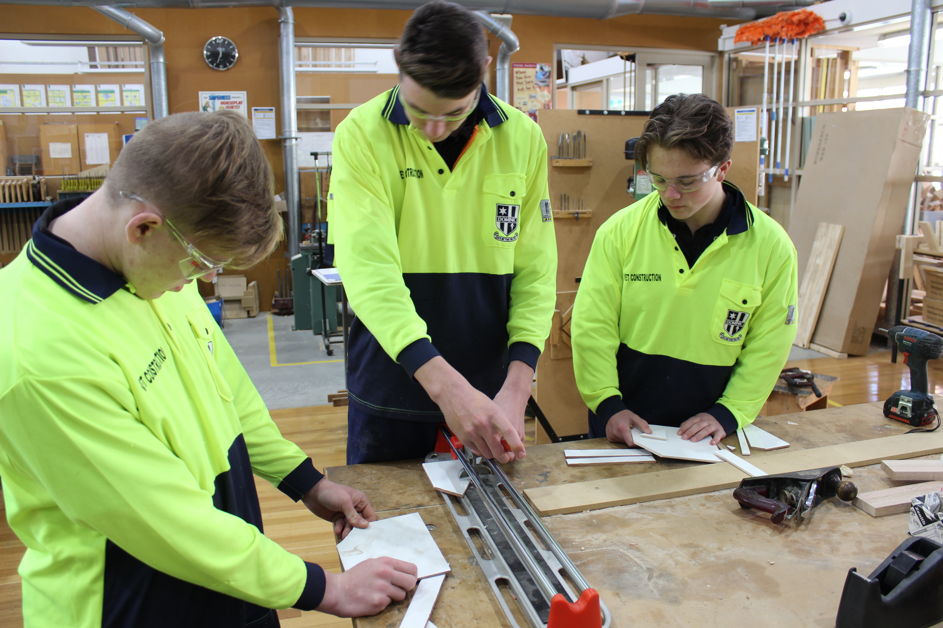
Introduction to Construction (VET)
Year 10 only course
Prepares students for working in the Construction industry
Students gain a White Card - industry recognised

Slide 3
Introduction to Construction (VET)
Preferred that students have taken Year 9 Design in Wood previously
Provided with a high vis shirt to wear in practical lessons
Combination of theory and practical
Guest speakers provide information about industry pathways

Slide 4
Find out more…
Please feel free to contact Mrs Selina Kinne, Head of Technology and Applied Studies, at skinne@dominic.tas.edu.au

